Slide 1
Week 7: Pointing here, pointing there, where is my pointer..?!
Spyros Mastorakis

Slide 2
Outline
Pointers
Questions on C-strings / Classes / Objects
Project 5
Coding

Slide 3
Pointers
It is a method of locating variables (data) in your program (in memory)
Pointers store address in memory
- not the value

Slide 4
Declaring a pointer
It is not the same thing to point to a char and to point to an integer or a float
Examples:
- int* number;
- char* character;
- float* greatnumber;

Slide 5
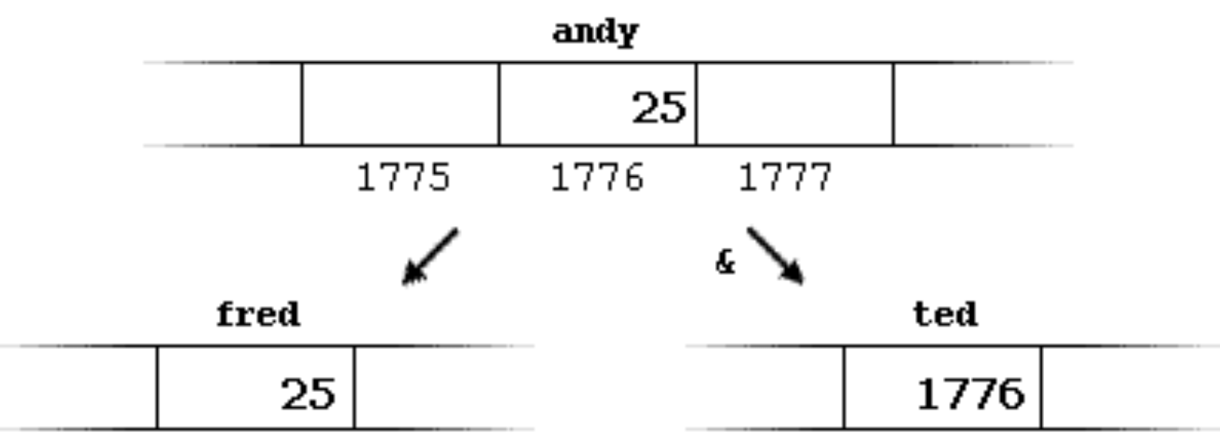
Example
andy = 25;
fred = andy;
ted = &andy;

Slide 6
* Means different things
Similar to arrays
- [] in variable declaration means size
- [] in code execution means position in array
With pointers
- * in variable declaration means it is a pointer
- * in code execution means get value by address

Slide 7
Reference operator
By reference people understand “by address”
By address people understand “by reference”
Operator & does
- Returns the address of a given variable name
- With every program run this address changes
- You cannot hardcode addresses

Slide 8
Dereference operator
Gets the value of a variable by a given address
Dangerous operation:
- Results in many bugs
- The type of the variable must match the type of the variable at the specified address

Slide 9
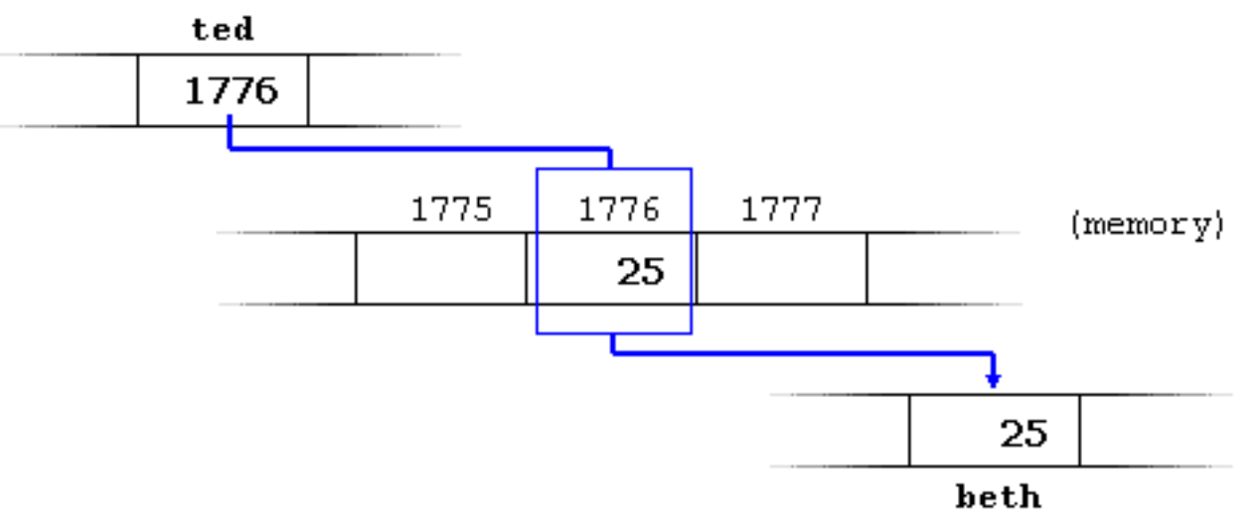
Example
beth = *ted;

Slide 10
Summary
& is the reference operator and can be read as "address of"
* is the dereference operator and can be read as "value pointed by"

Slide 11
Exercise (1)
#include <iostream>
using namespace std;
int main ()
{
int firstvalue, secondvalue;
int * mypointer;
mypointer = &firstvalue;
*mypointer = 10;
mypointer = &secondvalue;
*mypointer = 20;
cout << "firstvalue is " << firstvalue << endl;
cout << "secondvalue is " << secondvalue << endl;
return 0;
}

Slide 12
Exercise (2)
#include <iostream>
using namespace std;
int main ()
{
int firstvalue = 5;
int secondvalue = 15;
int * p1, * p2;
p1 = &firstvalue;
p2 = &secondvalue;
*p1 = 10;
*p2 = *p1;
p1 = p2;
*p1 = 20;
cout << "firstvalue is " << firstvalue << endl;
cout << "secondvalue is " << secondvalue << endl;
return 0;
}

Slide 13

Questions on C-strings

Slide 14
Project 5

Slide 15
WE ❤️ CODING! ☺

Slide 16
Problem 1
Iterate over the elements of an array using pointers and find their average value

